Slide 1

IPL PLAYER ANALYSIS
USING POWER BI
Midhunesh G 23BDS026

Slide 2
Objective
Analyze IPL player performances using key metrics such as total runs, strike rate, batting average, and boundary contributions.
Identify top-performing players based on total runs, centuries, and fifties.
Assess player consistency and efficiency across multiple matches.
Evaluate the impact of boundary runs (fours and sixes) on overall performance.
Provide data-driven insights to help in player selection, match strategies, and performance improvement.

Slide 3
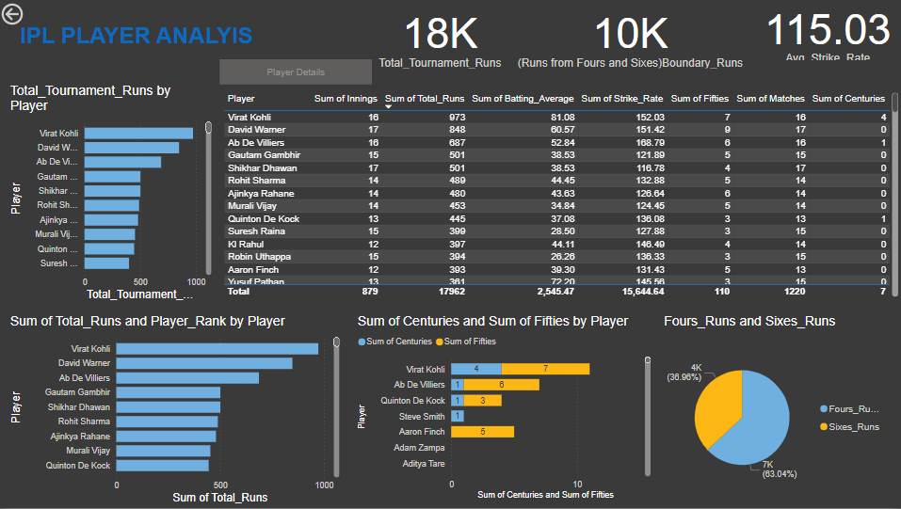

Slide 4


Slide 5
Insights gained
Top Scorers: Virat Kohli leads with 973 runs, followed by David Warner and AB de Villiers.
Strike Rate Impact: Players like AB de Villiers (168.79) and Virat Kohli (152.03) maintain a high strike rate.
Consistency: Virat Kohli also leads in centuries (4) and fifties (7), showcasing consistency.
Boundary Contribution: 63% of total runs come from sixes, highlighting aggressive playstyles.
Conclusion
The analysis highlights Virat Kohli as the most consistent and high-scoring player. AB de Villiers and David Warner also showcase exceptional performances.
The high percentage of boundary runs indicates a preference for power hitting in IPL.
These insights can help in player selection and match strategies.

